Slide 1

Cluster Analysis
GOA COLLEGE OF ENGINEERING
Affiliated to Goa University
INFORMATION TECHNOLOGY DEPARTMENT
Vision
Impart high quality knowledge and skills to students in the field of Information Technology ,motivate research, encourage industry consultancy projects and nurture human values and life skills.
Prepared By,
Ms. Diana Miranda
Assistant Professor
Dept. of Information Technology
Goa College of Engineering

Slide 2
Topics to be Covered
Cluster Analysis
Basic Concepts
Partitioning Methods
Hierarchical Methods
Density-Based Methods
Grid-Based Methods
Model-Based Clustering Methods
Evaluation of Clustering

Slide 3
Basic Concepts

Slide 4
What is Cluster Analysis?
Cluster Analysis or Clustering: Process of partitioning of data objects into subsets
Each subset is a cluster such that inter cluster variability and intra-cluster similarity is achieved
Set of clusters obtained from cluster analysis is called a clustering
Advantage of clustering: Automatically finds the groupings
Can be used for outlier detection: Values far away from any cluster are considered to be outliers

Slide 5
Also Called
Automatic Classification: A cluster of data objects can be treated as an implicit class
Data Segmentation: Partitions data into large groups based on their similarity
Unsupervised Learning: Class labels are not present. Hence, it is a form of learning by observation, rather than learning by example.

Slide 6
Typical Requirements for Clustering
Scalability
Clustering all the data instead of only on samples
Ability to deal with different types of attributes
Numerical, binary, categorical, ordinal, linked, and mixture of these
Constraint-based clustering
User may give inputs on constraints
Use domain knowledge to determine input parameters
Interpretability and usability
Discovery of clusters with arbitrary shape
Ability to deal with noisy data
Incremental clustering and insensitivity to input order
High dimensionality

Slide 7
Considerations for Cluster Analysis
Partitioning criteria
Single level vs. hierarchical partitioning (often, multi-level hierarchical partitioning is desirable)
Separation of clusters
Exclusive (e.g., one customer belongs to only one region) vs. non-exclusive (e.g., one document may belong to more than one class)
Similarity measure
Distance-based (e.g., Euclidian, road network, vector) vs. connectivity-based (e.g., density or contiguity)
Clustering space
Full space (often when low dimensional) vs. subspaces (often in high-dimensional clustering)

Slide 8
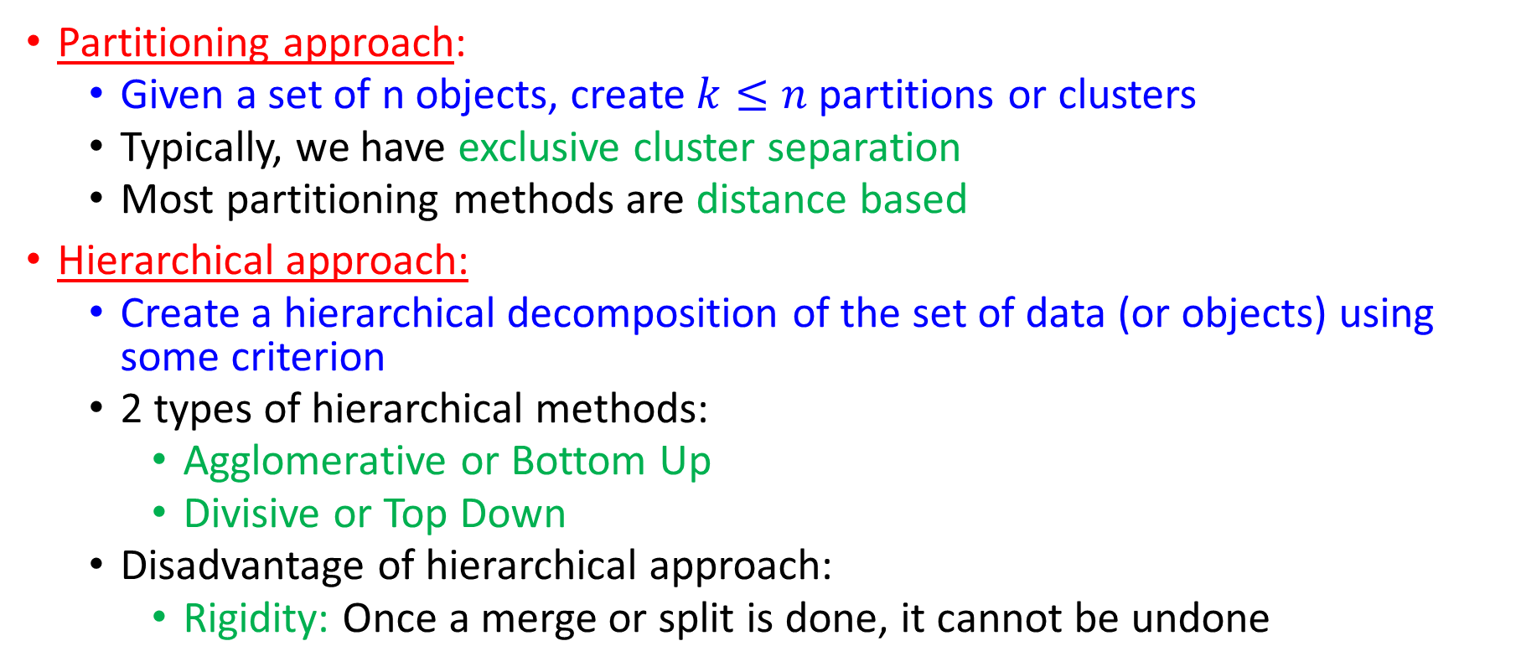
Overview of Basic Clustering Methods
Partitioning approach:
Given a set of n objects, create $k≤n$partitions or clusters
Typically, we have exclusive cluster separation
Most partitioning methods are distance based
Hierarchical approach:
Create a hierarchical decomposition of the set of data (or objects) using some criterion
2 types of hierarchical methods:
Agglomerative or Bottom Up
Divisive or Top Down
Disadvantage of hierarchical approach:
Rigidity: Once a merge or split is done, it cannot be undone

Slide 9
Overview of Basic Clustering Methods
Density-based approach:
Most partitioning methods generate clusters of spherical shapes: Find it difficult to generate clusters of arbitrary shape
General idea: Continue growing a cluster as long as the density in the neighbourhood exceeds some threshold
Can be useful to identify outliers
Typically considers exclusive clusters only

Slide 10
Overview of Basic Clustering Methods
Grid-based approach:
Quantize the object space into a finite number of cells that form a grid like structure
All the clustering operations are performed on this structure
Advantage: Fast processing time which is independent of the number of data objects but depends on the number of cells in each dimension
Model-based:
A model is hypothesized for each of the clusters and tries to find the best fit of that model to each other
Uses probability

Slide 11
Partitioning Methods

Slide 12
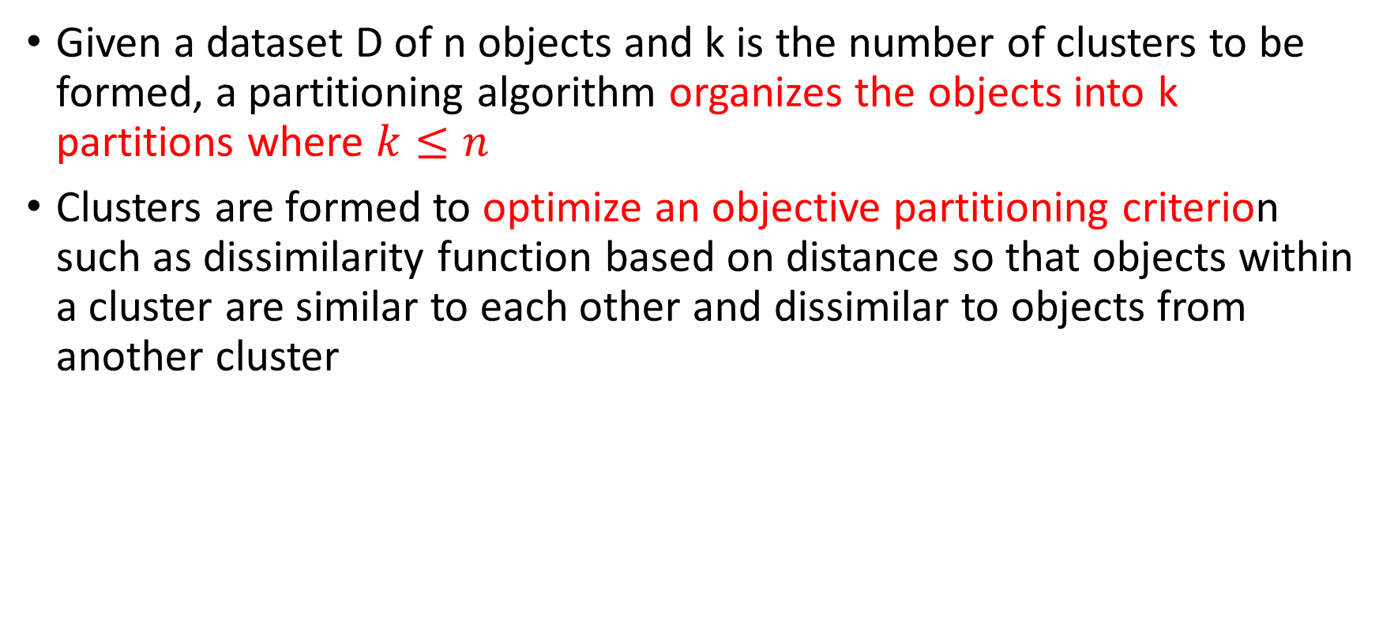
Given a dataset D of n objects and k is the number of clusters to be formed, a partitioning algorithm organizes the objects into k partitions where $k≤n$
Clusters are formed to optimize an objective partitioning criterion such as dissimilarity function based on distance so that objects within a cluster are similar to each other and dissimilar to objects from another cluster

Slide 13
K-Means: A Centroid Based Technique
Algorithm k-Means(k,D)
Input-: k: Number of clusters, D: Dataset of n objects
Output-: A set of k clusters
Method-:
Arbitrarily choose k objects from D as cluster centers
Repeat until no change
Calculate distance from each data object to all the cluster centers
Assign each object to the cluster of its nearest centroid
Update the cluster centers with the means of the newly assigned data objects

Slide 14
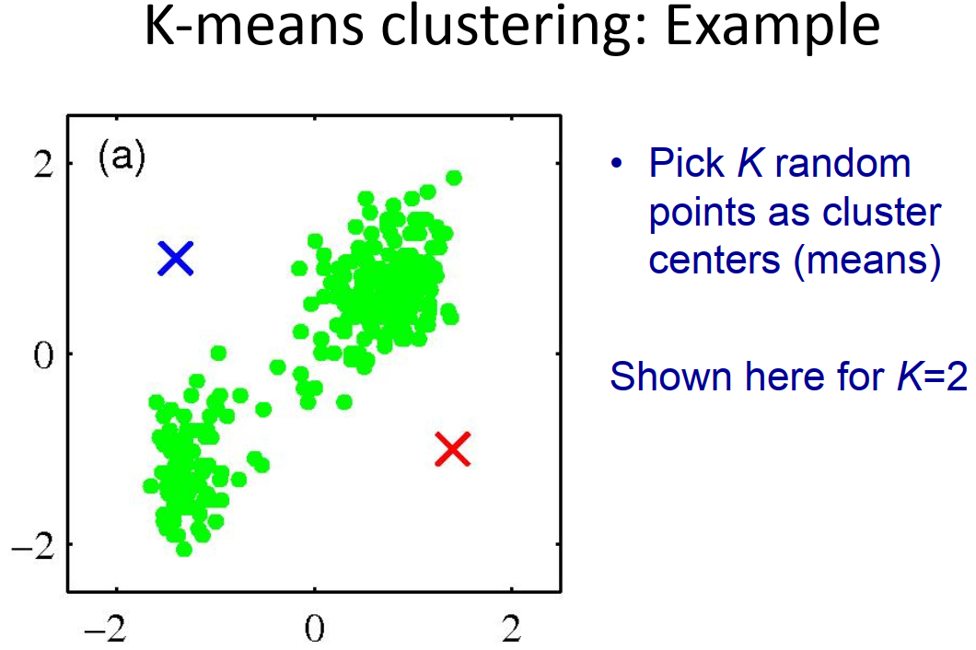

Slide 15
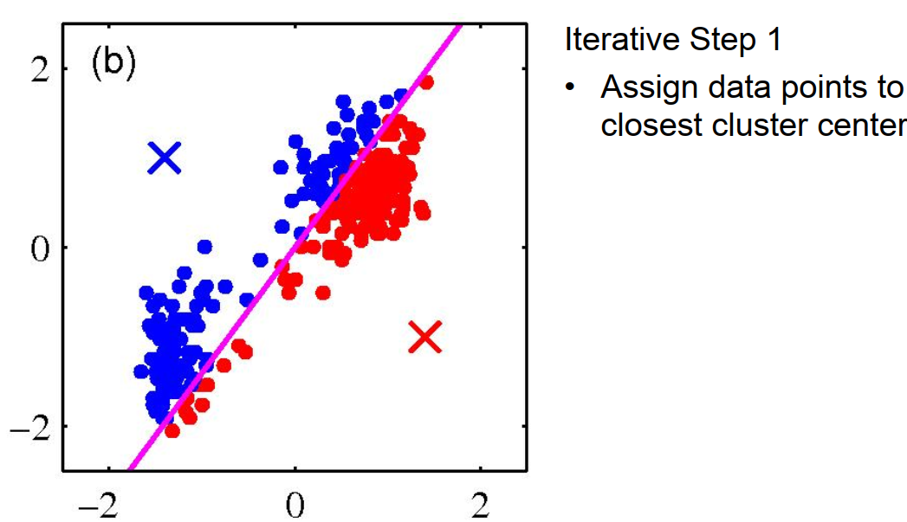

Slide 16
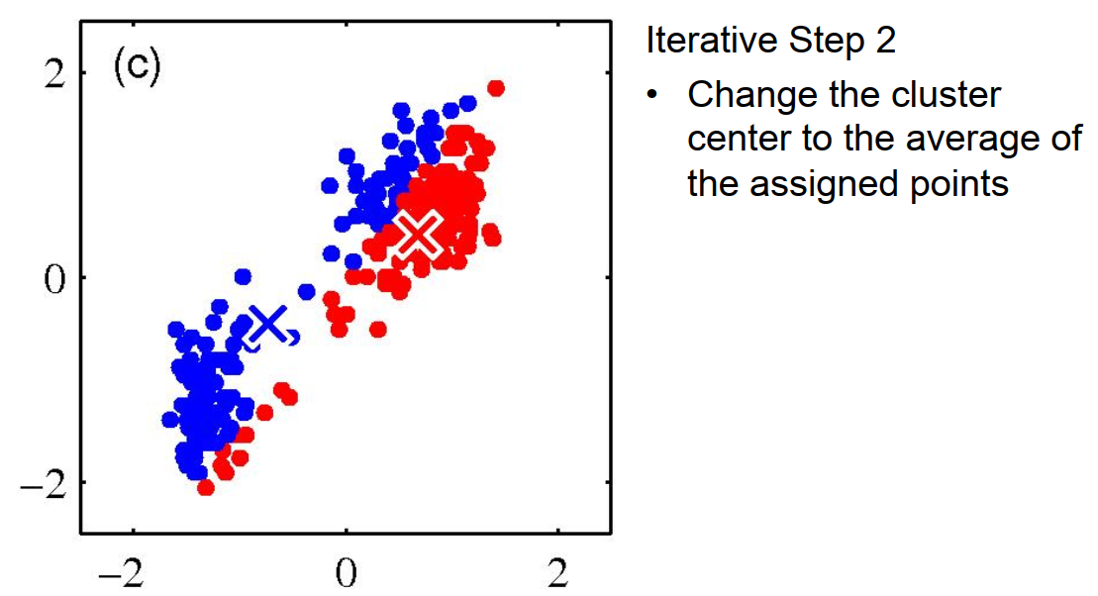

Slide 17
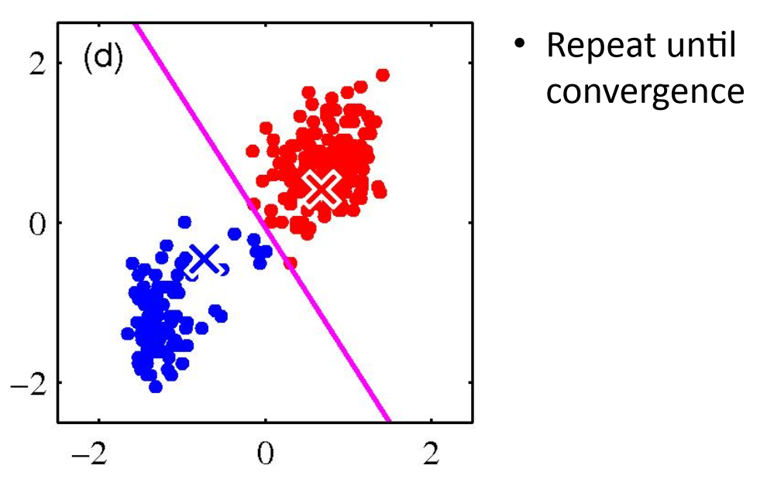

Slide 18
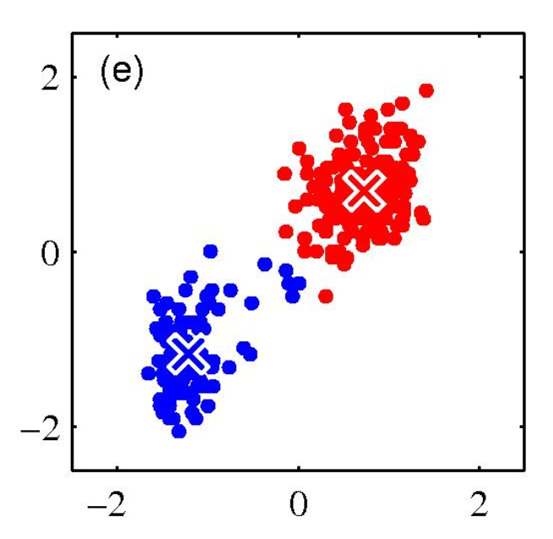

Slide 19
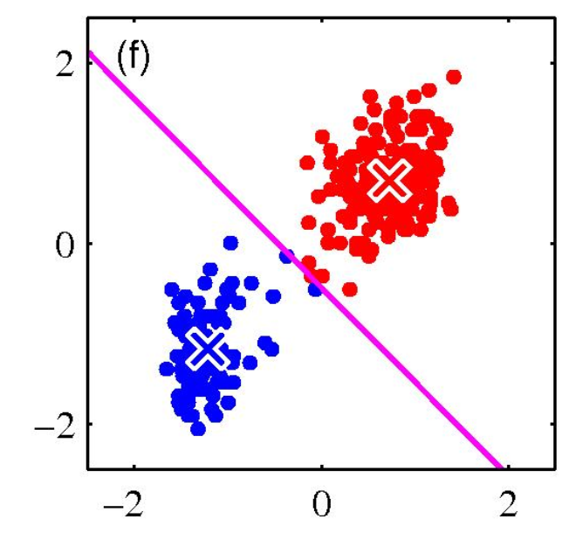

Slide 20
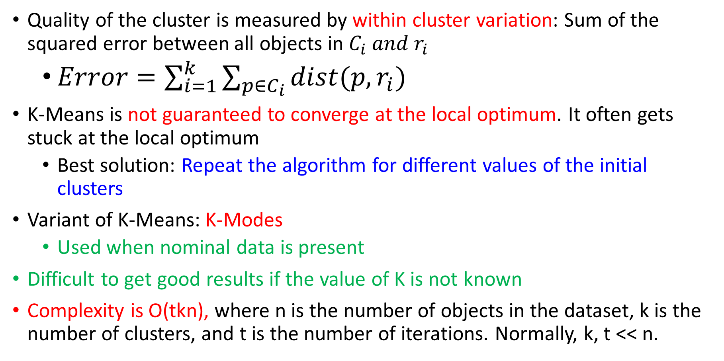
Quality of the cluster is measured by within cluster variation: Sum of the squared error between all objects in $C_{i} and r_{i}$
$Error=\sum_{i=1}^{k}{\sum_{p∈C_{i}}{dist(p,r_{i})}}$
K-Means is not guaranteed to converge at the local optimum. It often gets stuck at the local optimum
Best solution: Repeat the algorithm for different values of the initial clusters
Variant of K-Means: K-Modes
Used when nominal data is present
Difficult to get good results if the value of K is not known
Complexity is O(tkn), where n is the number of objects in the dataset, k is the number of clusters, and t is the number of iterations. Normally, k, t << n.

Slide 21
Drawback of K-Means
Sensitive to outliers: An object with an extremely large value may substantially distort the distribution of the data
Applicable only to objects in a continuous n-dimensional space
Using the k-modes method for categorical data
In comparison, k-medoids can be applied to a wide range of data
Need to specify k, the number of clusters, in advance
Sensitive to noisy data and outliers
Not suitable to discover clusters with non-convex shapes

Slide 22
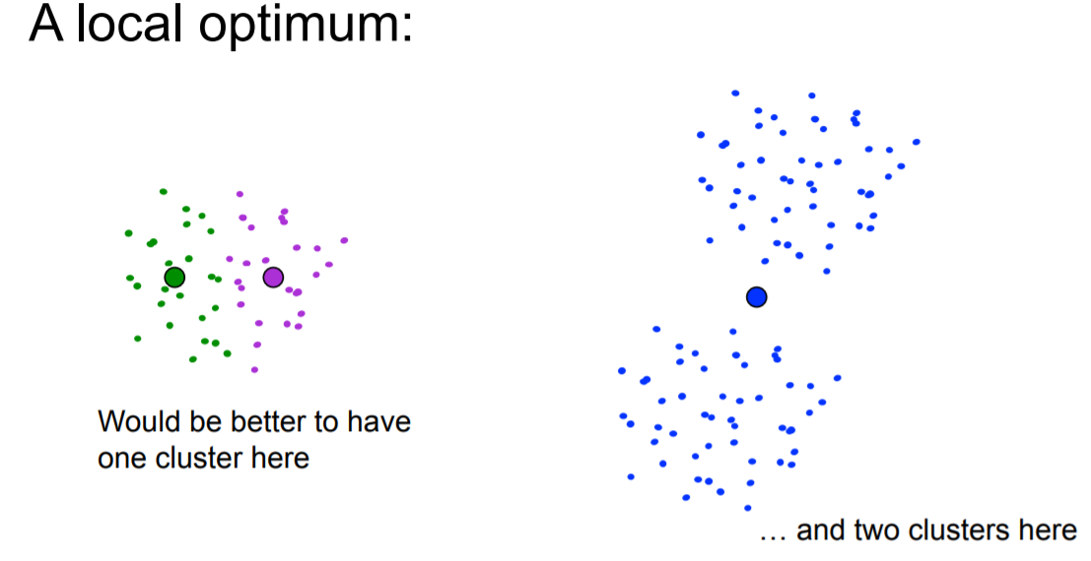

Slide 23
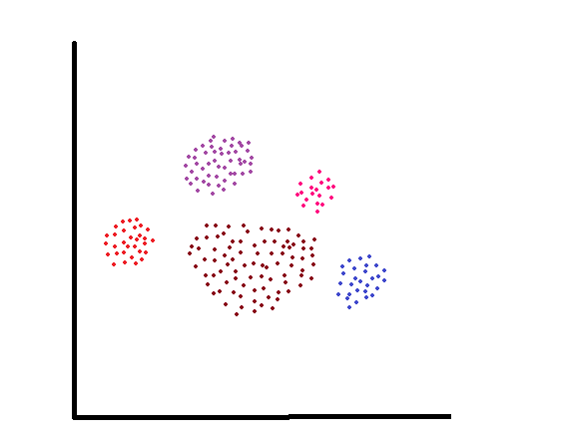
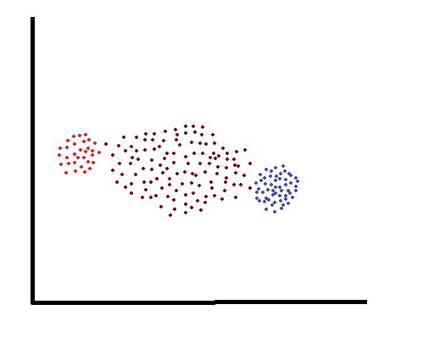
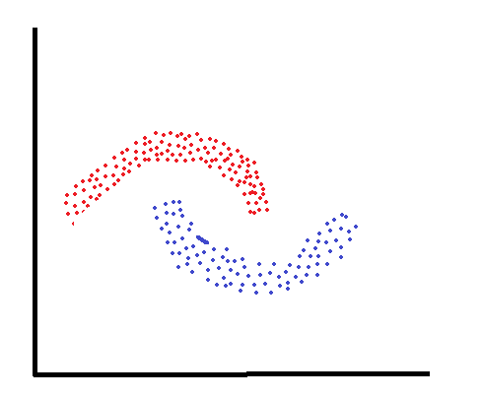
Comments on k-Means algorithm
Cluster with different sizes
Cluster with different densities
Non-convex shaped clusters
Some failure instance of k-Means algorithm

Slide 24
Consider points 1, 2, 3, 8, 9, 10, 25 in 1-dimensional space with k=2.
The correct clusters should be
Cluster 1={1, 2, 3}
Cluster 2={8, 9, 10}
Outlier=25
Scenario A:
Cluster 1={1, 2, 3}
Cluster 2={8, 9, 10, 25}
Within Cluster Variation= 196
Scenario B:
Cluster 1={1, 2, 3, 8}
Cluster 2={9, 10, 25}
Within Cluster Variation= 189.67
Wrong

Slide 25
K-Modes Method
Handling categorical data
Replacing means of clusters with modes
Using new dissimilarity measures to deal with categorical objects
Using a frequency-based method to update modes of clusters

Slide 26
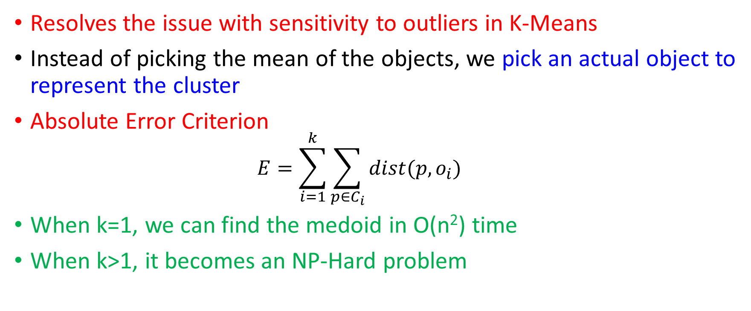
K-Medoids
Resolves the issue with sensitivity to outliers in K-Means
Instead of picking the mean of the objects, we pick an actual object to represent the cluster
Absolute Error Criterion
$$E=\sum_{i=1}^{k}{\sum_{p∈C_{i}}{dist(p,o_{i})}}$$
When k=1, we can find the medoid in O(n²) time
When k>1, it becomes an NP-Hard problem

Slide 27
Algorithm K-Medoid(K,D)
Input-: K: Number of clusters, D: Dataset of n objects
Output-: A set of K clusters
Method-:
Arbitrarily choose K objects from D as cluster representatives
Repeat until no change
Calculate distance from each data object to all the cluster representatives O_{j} Assign each object to the cluster of its nearest cluster representatives
Randomly select a non-representative object O_{random}
Compute the cost S of swapping representative object O_{j} with O_{random}
If S<0 then
Swap O_{j} with O_{random} to form a new set of K representative objects

Slide 28
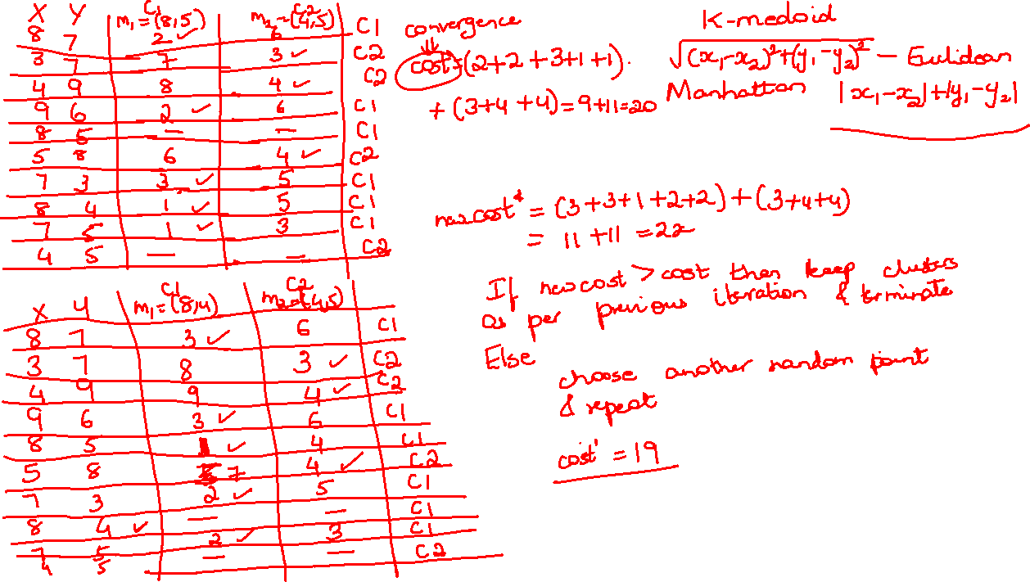

Slide 31
CLARA
Clustering LARge Applications
Uses a random sample of the dataset instead of taking the whole data
Ideally: Sample should represent the whole data
Effectiveness depends on the sample size
CLARANS
Clustering LARge Applications based upon Randomized Search
Presents a tradeoff between the cost and effectiveness of using samples to improve clustering
Procedure
Randomly selects K objects in the dataset as the current medoids
Randomly selects a current medoid x and an object y that is not one of the current medoids
Can replacing x with y improve the absolute error criterion? If yes, then replace x with y
CLARANS conducts such a randomized search l times. The set of current medoids after the l steps is considered a local optimum
Repeats this m times and returns the best local optimum as the final result

Slide 32
Hierarchical Methods

Slide 33
Groups data objects into a hierarchy or tree of clusters
Useful for data summarization and visualization
Selection of merge or split points is critical: If not well chosen, it may lead to low quality clusters
Multi-Phase Clustering: Integrates clustering with other techniques

Slide 34
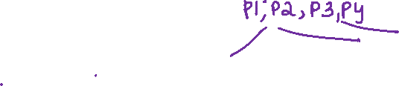
Agglomerative Clustering
Bottom up strategy
Starts with each object forming one cluster and repeatedly merges the clusters till a single cluster becomes the root of the hierarchy
Requires at most n iterations
Merges 2 clusters based on a similarity measure
Divisive Clustering
Top down strategy
Starts with all objects being placed in one cluster and recursively partitions the cluster till all the clusters contain a single object or the objects within a cluster are sufficiently similar to each other
Both methods can specify the number of clusters as a terminating condition

Slide 35
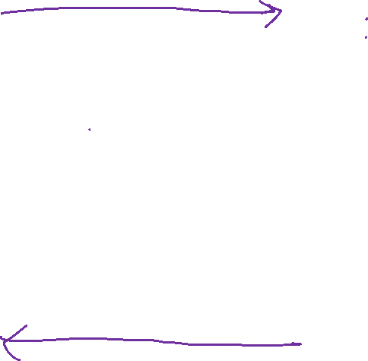
AGNES (AGglomerative NESting)
Merges 2 clusters C1 and C2 if an object in C1 and an object in C2 form the minimum Euclidean distance between any 2 objects from different clusters
Single Linkage Approach: Each cluster is represented by all objects in the cluster and the similarity between 2 clusters is measured by the similarity of the closest pair of data points belonging to different clusters
DIANA (DIvisive ANAlysis)
Clusters are split according to some principle such as maximum Euclidean distance between the closes neighbouring objects in a cluster
Step 0
Step 1
Step 2
Step 3
Step 4
agglomerative
(AGNES)
a
a b
b
a b c d e
c
c d e
d
d e
e
divisive
(DIANA)
Step 4
Step 3
Step 2
Step 1
Step 0

Slide 36
Dendrogram
Tree like structure that represents the process of hierarchical clustering
Challenge with Divisive Clustering
How to partition a large cluster into several small ones?
There are 2^{n-1}-1 possible ways to partition a set of n objects into 2 exclusive subsets where n is the number of objects

Slide 37
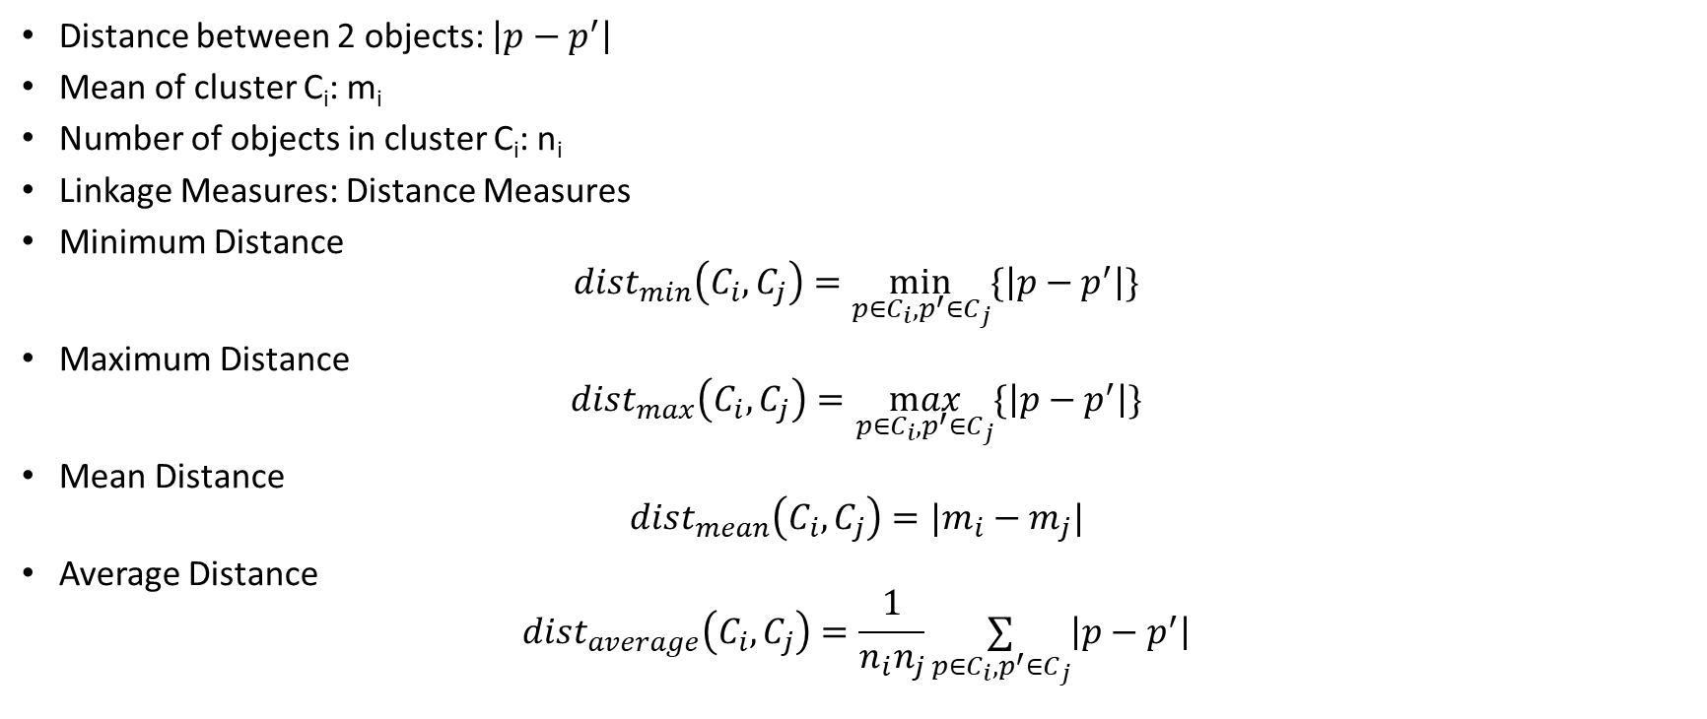
Distance Measures
Distance between 2 objects: $\left|p−p^{′}\right|$
Mean of cluster C_{i}: m_{i}
Number of objects in cluster C_{i}: n_{i}
Linkage Measures: Distance Measures
Minimum Distance
$$dist_{min}\left(C_{i},C_{j}\right)=\min_{p∈C_{i}, p^{′}∈C_{j}}{\{\left|p−p^{′}\right|\}}$$
Maximum Distance
$$dist_{max}\left(C_{i},C_{j}\right)=\max_{p∈C_{i}, p^{′}∈C_{j}}{\{\left|p−p^{′}\right|\}}$$
Mean Distance
$$dist_{mean}\left(C_{i},C_{j}\right)=|m_{i}−m_{j}|$$
Average Distance
$$dist_{average}\left(C_{i},C_{j}\right)=\frac{1}{n_{i}n_{j}}\underset{p∈C_{i}, p^{′}∈C_{j}}{∑}\left|p−p^{′}\right|$$

Slide 38
Nearest Neighbour Clustering Algorithm:
Algorithm that uses minimum distance to measure the distance between clusters
Also called minimum spanning tree algorithm
Single Linkage Algorithm: Clustering process is terminated when the distance between nearest clusters exceeds a user defined threshold
Farthest Neighbour Clustering Algorithm
Uses maximum distance to measure the distance between clusters
Tends to minimize the increase in the diameter of the clusters at each iteration

Slide 42
Single Linkage Example
Clustering process is terminated when the distance between nearest clusters exceeds a user defined threshold
Can result in “straggly” (long and thin) clusters due to chaining effect.
After merging c_{i} and c_{j}, the similarity of the resulting cluster to another cluster, c_{k}, is:

Slide 43
Complete Linkage Algorithm
Clustering process is terminated when the maximum distance between nearest clusters exceeds a user defined threshold
Makes “tighter,” spherical clusters that are typically preferable.
After merging c_{i} and c_{j}, the similarity of the resulting cluster to another cluster, c_{k}, is:

Slide 44
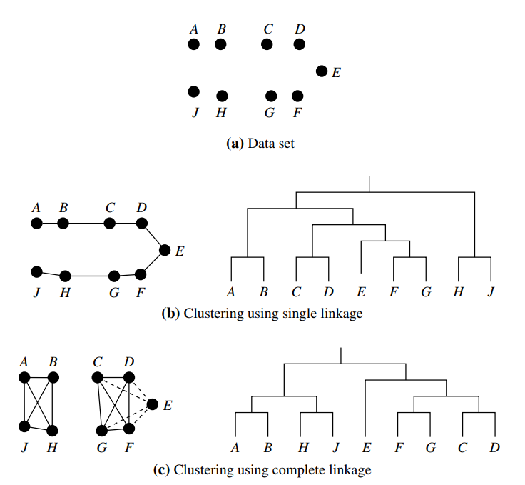

Slide 45

Mean distance is a compromise between minimum and maximum distance.
Overcomes the outlier sensitivity problem
Handles categoric as well as numeric data

Slide 46
BIRCH Algorithm
Balanced Iterative Reducing and Clustering using Hierarchies
Clusters large amounts of numeric data
Integrates hierarchical clustering (at the initial microclustering stage) and iterative clustering (at the macro clustering stage)
Overcomes 2 difficulties in agglomerative clustering
Scalability
Inability to undo the previous step
Uses a Clustering Feature Tree (CF Tree) to represent a cluster hierarchy

Slide 47
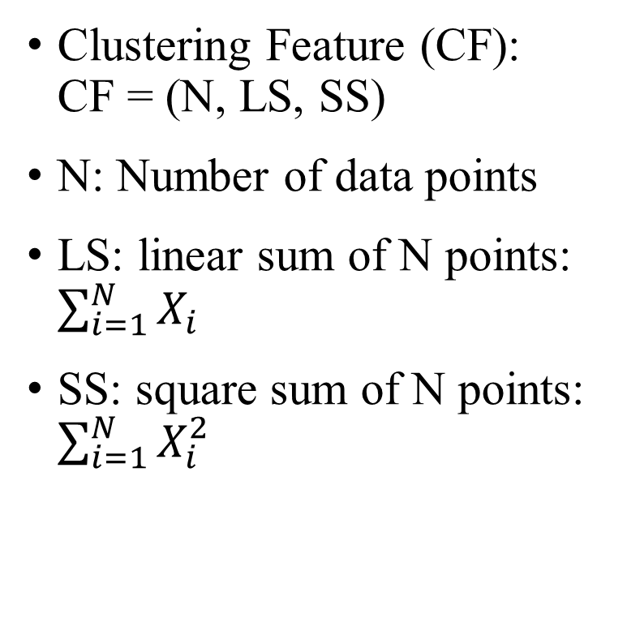
Clustering Feature Vector in BIRCH
Clustering Feature (CF): CF = (N, LS, SS)
N: Number of data points
LS: linear sum of N points: $\sum_{i=1}^{N}{X_{i}}$
SS: square sum of N points: $\sum_{i=1}^{N}{X_{i}^{2}}$
(3,4)
(2,6)
(4,5)
(4,7)
(3,8)
CF = (5, (16,30),(54,190))

Slide 48
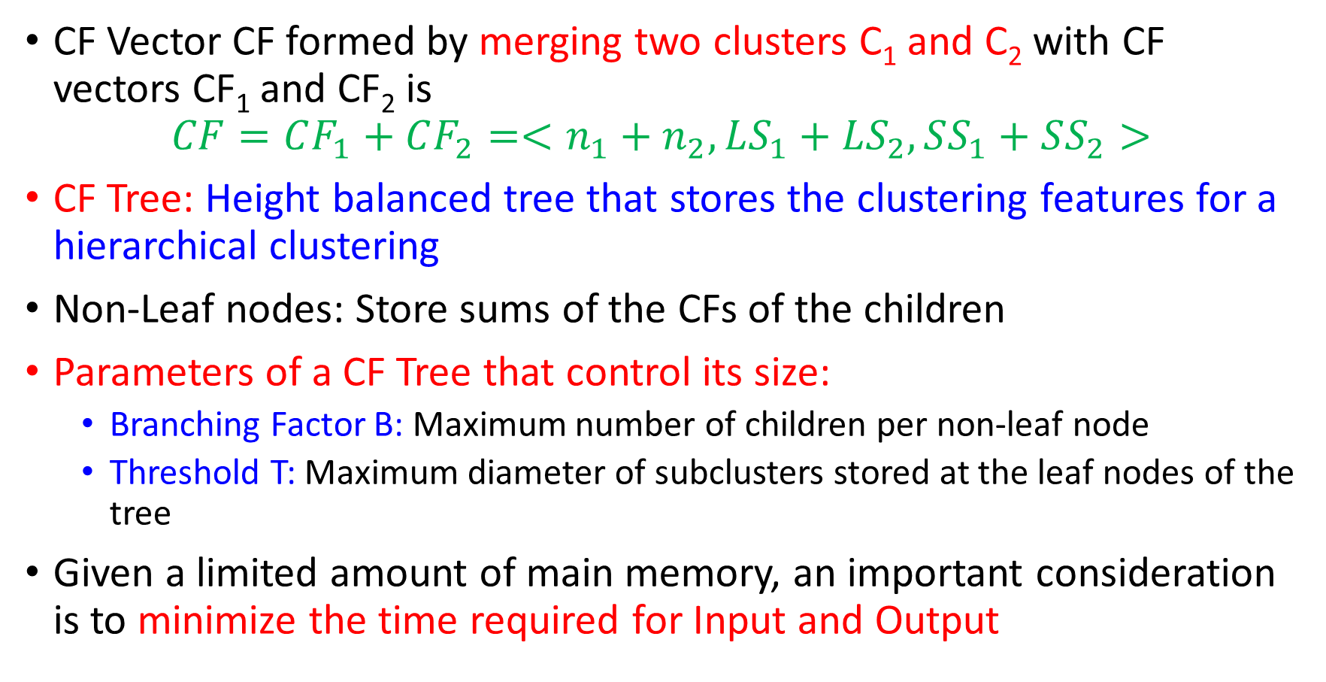
CF Vector CF formed by merging two clusters C₁ and C₂ with CF vectors CF₁ and CF₂ is
$$CF=CF_{1}+CF_{2}=<n_{1}+n_{2},LS_{1}+LS_{2}, SS_{1}+SS_{2}>$$
CF Tree: Height balanced tree that stores the clustering features for a hierarchical clustering
Non-Leaf nodes: Store sums of the CFs of the children
Parameters of a CF Tree that control its size:
Branching Factor B: Maximum number of children per non-leaf node
Threshold T: Maximum diameter of subclusters stored at the leaf nodes of the tree
Given a limited amount of main memory, an important consideration is to minimize the time required for Input and Output

Slide 49
The CF Tree Structure
Root
B = 7
L = 6
CF₁
CF₂
CF₃
CF₆
child₁
child₂
child₃
child₆
Non-leaf node
CF₁
CF₂
CF₃
CF₅
child₁
child₂
child₃
child₅
Leaf node
Leaf node
prev
CF₁
CF₂
CF₆
next
prev
CF₁
CF₂
CF₄
next

Slide 50
Applies a Multi-phase Clustering Technique
Phase 1:
Incremental in nature
Scans the DB to build an initial in-memory CF tree (a multi-level compression of the data that tries to preserve the inherent clustering structure of the data)
Phase 2:
Applies an arbitrary clustering algorithm to cluster the leaf nodes of the CF-tree
Removes sparse clusters as outliers and groups dense clusters into larger ones
Time complexity: O(n)
Flaws
Each node in a CF tree can hold only a limited number of entries due to its size. Therefore a CF tree does not always correspond to a natural cluster
Uses notion of radius to control the cluster boundary. Therefore it does not perform well if the clusters are not spherical

Slide 51
Chameleon
Multiphase Hierarchical Clustering using Dynamic Modeling
Uses dynamic modeling to determine the similarity between pairs of clusters
Cluster similarity is assessed based on:
How well connected objects are within a cluster?
Proximity of the cluster
2 clusters are merged if their interconnectivity is high and they are close together
Does not depend on a static user supplied model and can automatically adapt to the internal characteristics of the clusters being merged

Slide 52
Overall Framework of CHAMELEON
Construct (K-NN)
Sparse Graph
Partition the Graph
Data Set
K-NN Graph
P and q are connected if q is among the top k closest neighbors of p
Merge Partition
Relative interconnectivity: connectivity of c₁ and c₂ over internal connectivity
Relative closeness: closeness of c₁ and c₂ over internal closeness
Final Clusters

Slide 53
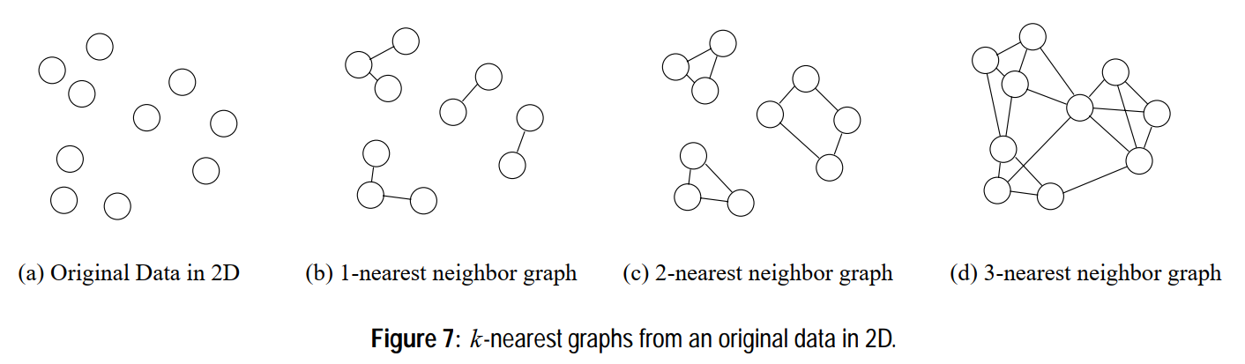

Slide 54
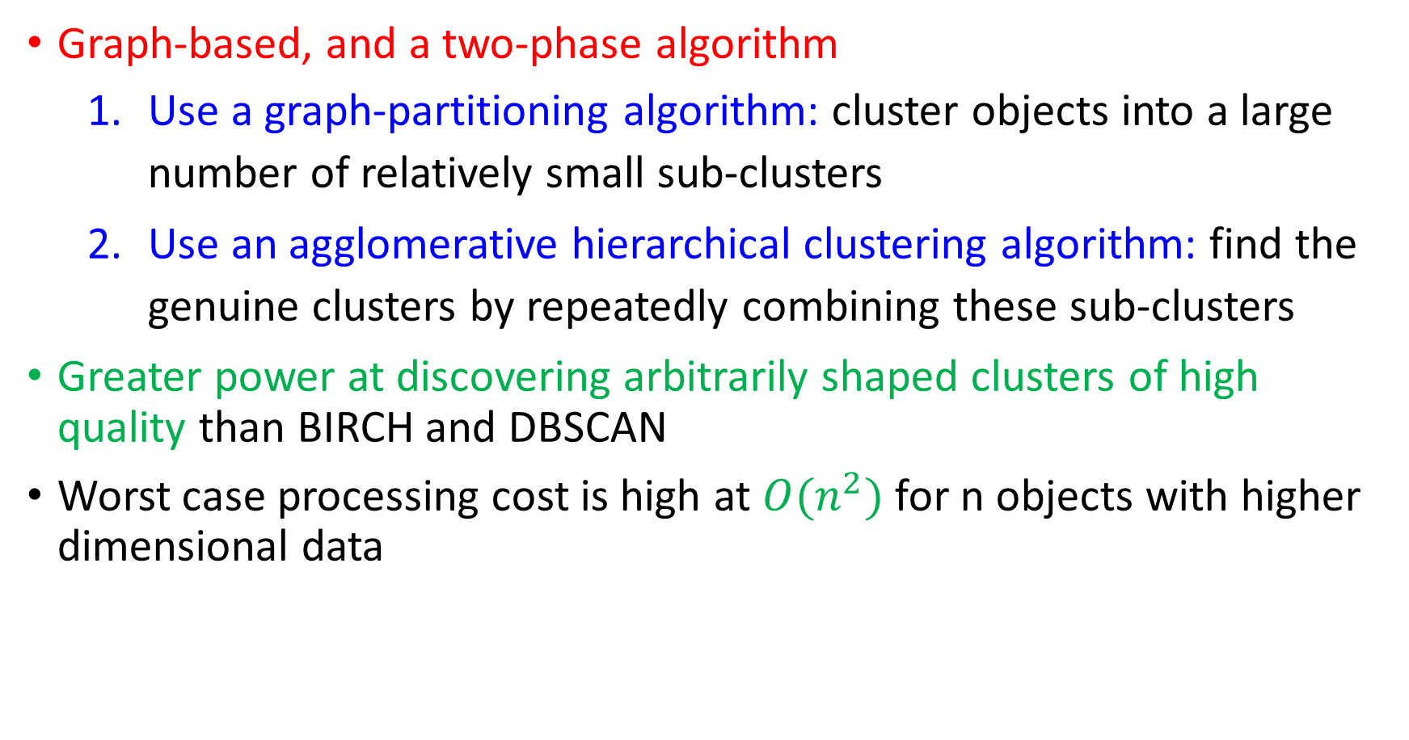
Graph-based, and a two-phase algorithm
Use a graph-partitioning algorithm: cluster objects into a large number of relatively small sub-clusters
Use an agglomerative hierarchical clustering algorithm: find the genuine clusters by repeatedly combining these sub-clusters
Greater power at discovering arbitrarily shaped clusters of high quality than BIRCH and DBSCAN
Worst case processing cost is high at $O(n^{2})$ for n objects with higher dimensional data

Slide 55
Probabilistic Hierarchical Clustering
Agglomerative hierarchical clustering suffers from the following drawbacks:
Non-trivial task to choose a good distance measure
Difficult to handle missing attribute values
At each step, we locally search for a good merging/splitting decision
Probabilistic hierarchical clustering aims to overcome some of these drawbacks

Slide 56
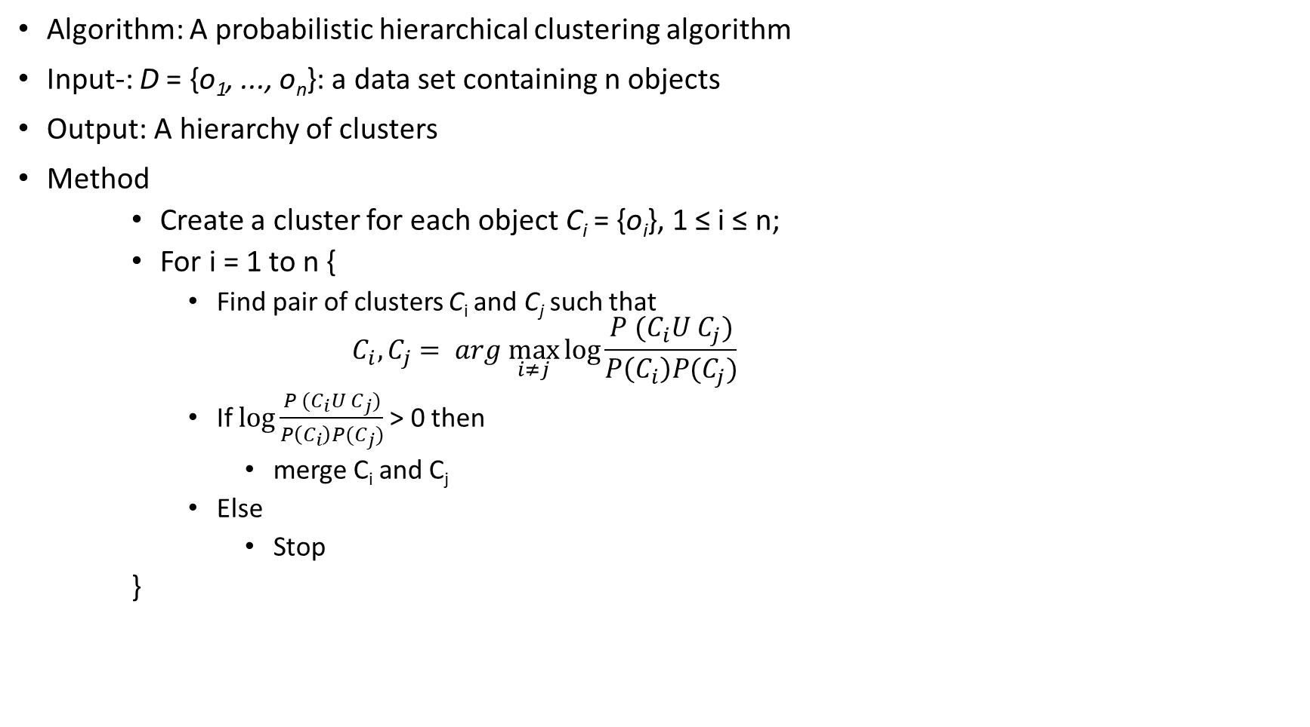
Algorithm: A probabilistic hierarchical clustering algorithm
Input-: D = {o₁, ..., o_{n}}: a data set containing n objects
Output: A hierarchy of clusters
Method
Create a cluster for each object C_{i} = {o_{i}}, 1 ≤ i ≤ n;
For i = 1 to n {
Find pair of clusters C_{i} and C_{j} such that
$$C_{i},C_{j}= arg \max_{i≠j}{\log{\frac{P (C_{i}U C_{j})}{P\left(C_{i}\right)P(C_{j})}}}$$
If $\log{\frac{P (C_{i}U C_{j})}{P\left(C_{i}\right)P(C_{j})}}$> 0 then
merge C_{i} and C_{j}
Else
Stop
}

Slide 57
Density Based Methods

Slide 58
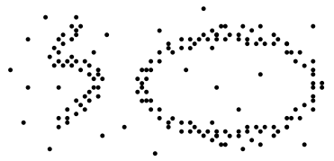
Partitioning and hierarchical methods have difficulty in finding clusters like a “ring” or “S” shaped
Density Based Methods model clusters as dense regions in the data space followed by sparse regions

Slide 59
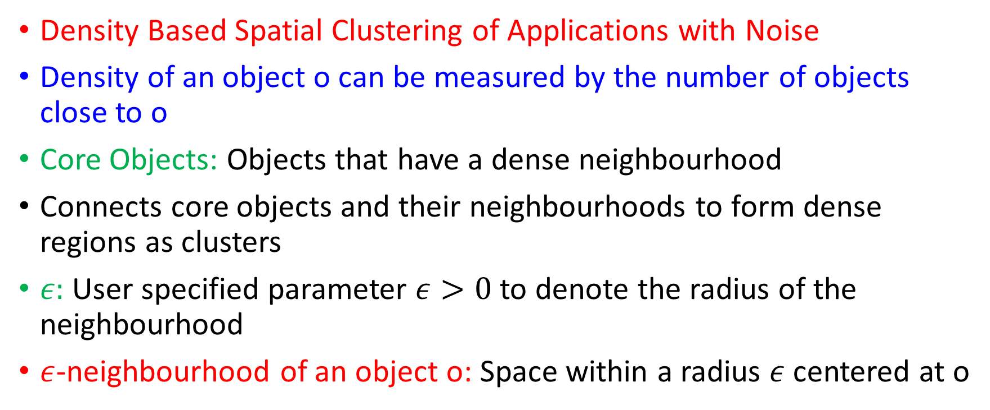
DBSCAN
Density Based Spatial Clustering of Applications with Noise
Density of an object o can be measured by the number of objects close to o
Core Objects: Objects that have a dense neighbourhood
Connects core objects and their neighbourhoods to form dense regions as clusters
$ε:$ User specified parameter $ε>0$to denote the radius of the neighbourhood
$ε$-neighbourhood of an object o: Space within a radius $ε$ centered at o

Slide 60
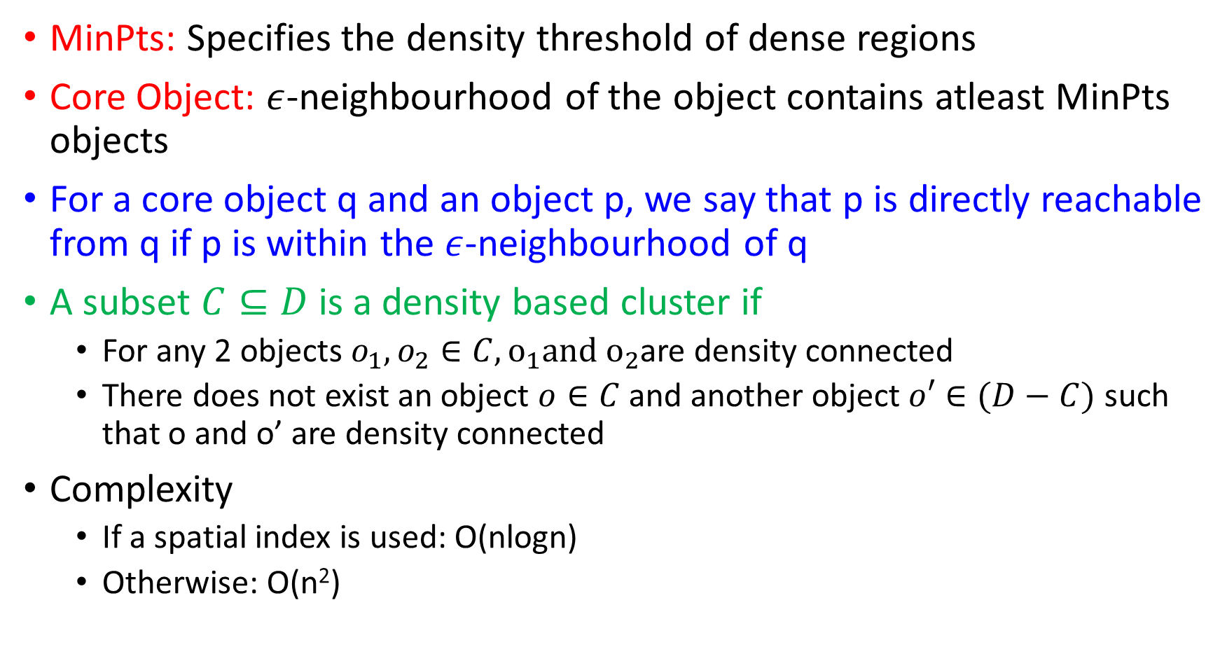
MinPts: Specifies the density threshold of dense regions
Core Object: $ε$-neighbourhood of the object contains atleast MinPts objects
For a core object q and an object p, we say that p is directly reachable from q if p is within the $ε$-neighbourhood of q
A subset $C⊆D$ is a density based cluster if
For any 2 objects $o_{1},o_{2}∈C, o_{1}and o_{2}$are density connected
There does not exist an object $o∈C$ and another object $o′∈(D−C)$ such that o and o’ are density connected
Complexity
If a spatial index is used: O(nlogn)
Otherwise: O(n²)

Slide 61
Density-Reachable and Density-Connected
p
Density-reachable:
A point p is density-reachable from a point q w.r.t. Eps, MinPts if there is a chain of points p₁, …, p_{n}, p₁ = q, p_{n} = p such that p_{i+1} is directly density-reachable from p_{i}
Density-connected
A point p is density-connected to a point q w.r.t. Eps, MinPts if there is a point o such that both, p and q are density-reachable from o w.r.t. Eps and MinPts
p₁
q
p
q
o

Slide 62
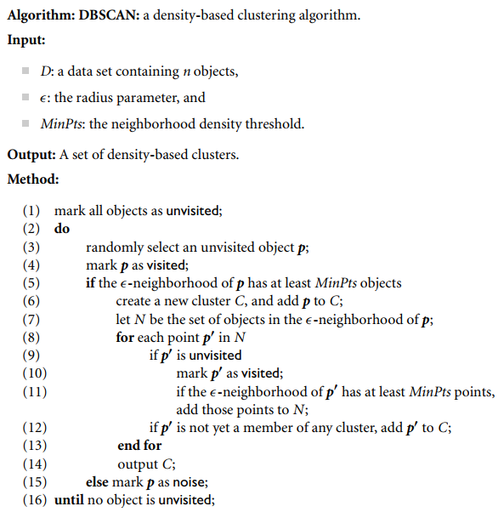
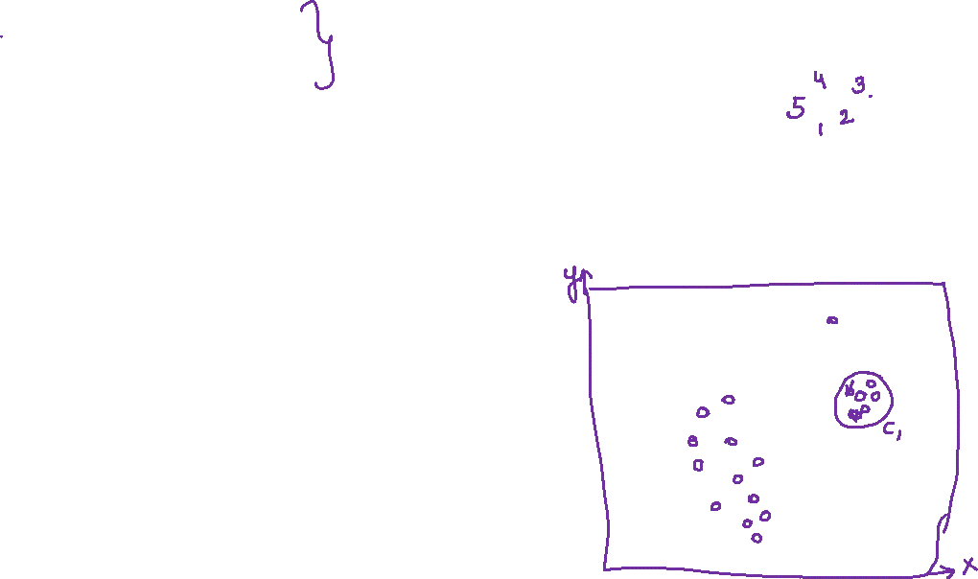
Outlier
Border
Eps = 1cm
MinPts = 5
Core

Slide 63
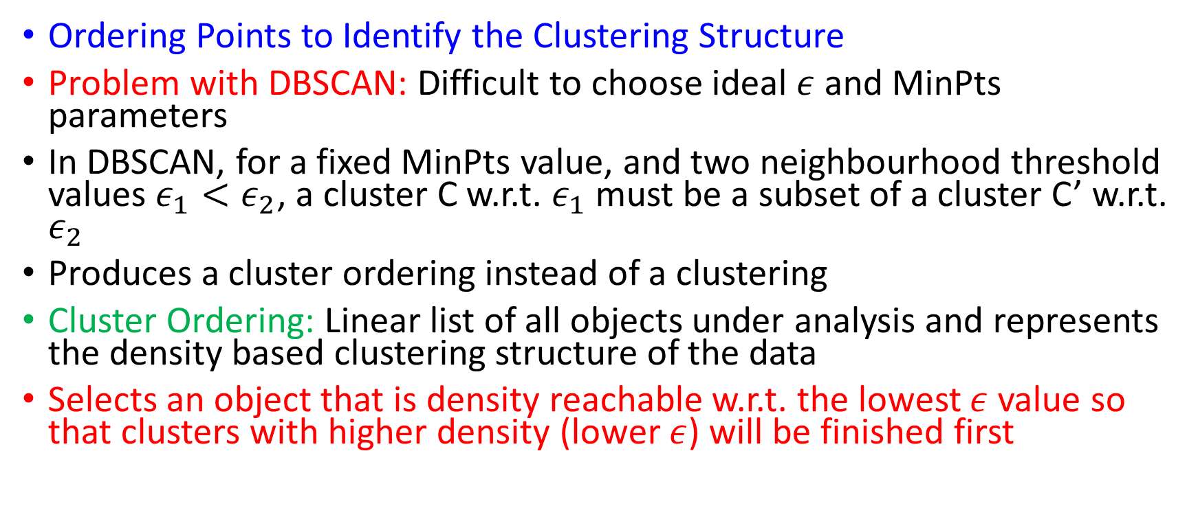
OPTICS
Ordering Points to Identify the Clustering Structure
Problem with DBSCAN: Difficult to choose ideal $ε$ and MinPts parameters
In DBSCAN, for a fixed MinPts value, and two neighbourhood threshold values $ε_{1}<ε_{2}$, a cluster C w.r.t. $ε_{1}$ must be a subset of a cluster C’ w.r.t. $ε_{2}$
Produces a cluster ordering instead of a clustering
Cluster Ordering: Linear list of all objects under analysis and represents the density based clustering structure of the data
Selects an object that is density reachable w.r.t. the lowest $ε$ value so that clusters with higher density (lower $ε$) will be finished first

Slide 64
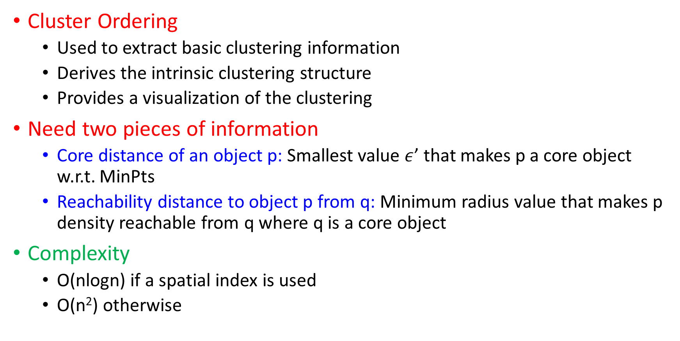
Cluster Ordering
Used to extract basic clustering information
Derives the intrinsic clustering structure
Provides a visualization of the clustering
Need two pieces of information
Core distance of an object p: Smallest value $ε$’ that makes p a core object w.r.t. MinPts
Reachability distance to object p from q: Minimum radius value that makes p density reachable from q where q is a core object
Complexity
O(nlogn) if a spatial index is used
O(n²) otherwise

Slide 65
OPTICS: Some Extension from DBSCAN
Index-based:
k = number of dimensions
N = 20
p = 75%
M = N(1-p) = 5
Complexity: O(NlogN)
Core Distance:
min eps s.t. point is core
Reachability Distance
D
p1
o
p2
o
Max (core-distance (o), d (o, p))
r(p1, o) = 2.8cm. r(p2,o) = 4cm
MinPts = 5
ε = 3 cm

Slide 66
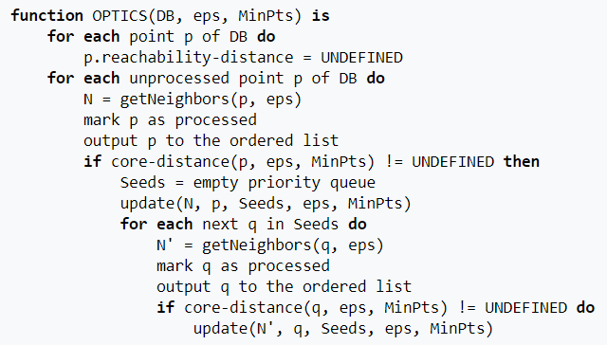
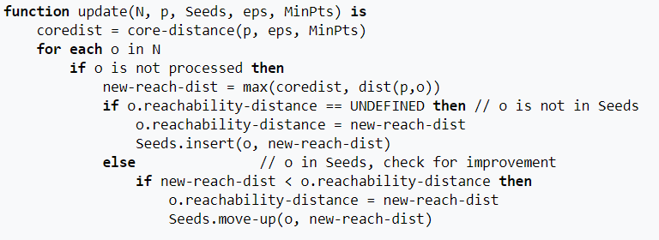

Slide 67
DENCLUE
DENsity based CLUstering
Kernel Function: Expresses the contribution of each point to the overall density function for kernel density estimation

Slide 68
Algorithm DENCLUE
Derive a density function for the space occupied by the data points
Identify local maxima (density attractors)
Assign each point to the density attractor by moving in the direction of maximum increase in density
Follow direction of maximum increase in density
Define clusters as groups consisting of points associated with a particular density attractor
Discard clusters whose density attractor has a density less than a user specified minimum ᶓ
Combine clusters connected by paths of points that are connected by points with density above ᶓ

Slide 69
DENCLUE
Advantages over DBSCAN and OPTICS:
Not highly sensitive to the radius

Slide 70
Grid Based Clustering

Slide 71
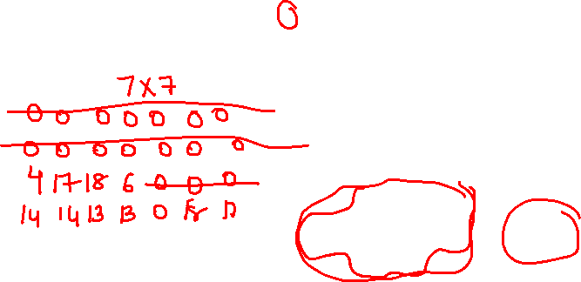
Grid-based Clustering

Slide 72
Uses a multiresolution grid data structure
Main advantage:
Fast processing time which is typically independent of the number of data objects, yet dependent on only the number of cells in each dimension in the quantized space

Slide 73
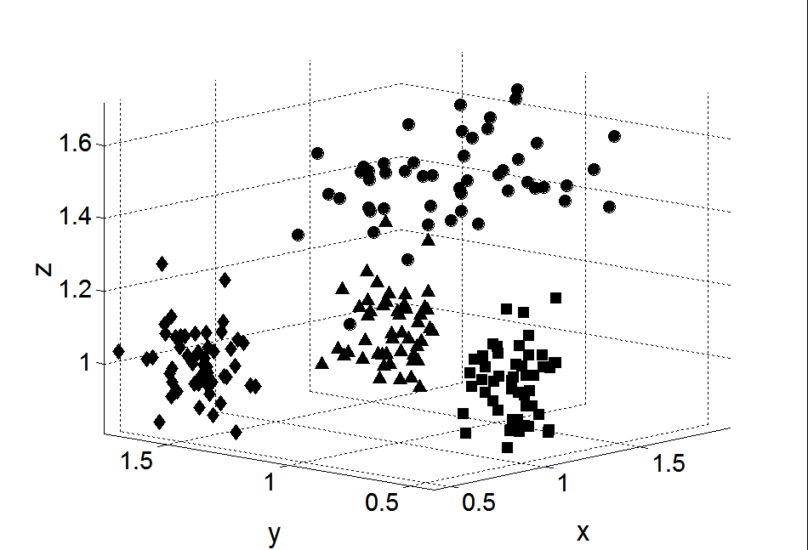
Subspace Clustering
Until now, we found clusters by considering all of the attributes
Some clusters may involve only a subset of attributes, i.e., subspaces of the data

Slide 74
STING
Statistical INformation Grid
Space is divided into rectangular cells in a hierarchical and recursive way
Each cell at a higher level is partitioned to form a number of cells at a lower level
Statistical parameters like mean, maximum, minimum and type of distribution are stored as attributes for each cell
Statistical parameters for higher levels are computed from the parameters of lower level cells
If the distribution of the lower level cells disagree with each other and fail the threshold test, the distribution type of the high level cell is set to none
As granularity approaches 0, STING becomes equivalent to DBSCAN

Slide 75
Advantages of STING:
Grid based computation is query independent
Facilitates parallel processing and incremental update
Efficient with time complexity of O(n), where n is the number of objects
Flaws of STING:
High cost of processing if granularity is fine
Does not consider the relationship between child and neighbouring cells for constructing parent cells. This results in isothetic clusters (Boundaries are either horizontal or vertical, but not diagonal)

Slide 76
CLIQUE
CLustering In QUEst
A grid-based clustering algorithm that methodically finds subspace clusters
Relies on the following property:
Monotone property of density-based clusters: If a set of points cannot form a density based cluster in k dimensions, then the same set of points cannot form a density based cluster in all possible supersets of those dimensions

Slide 77
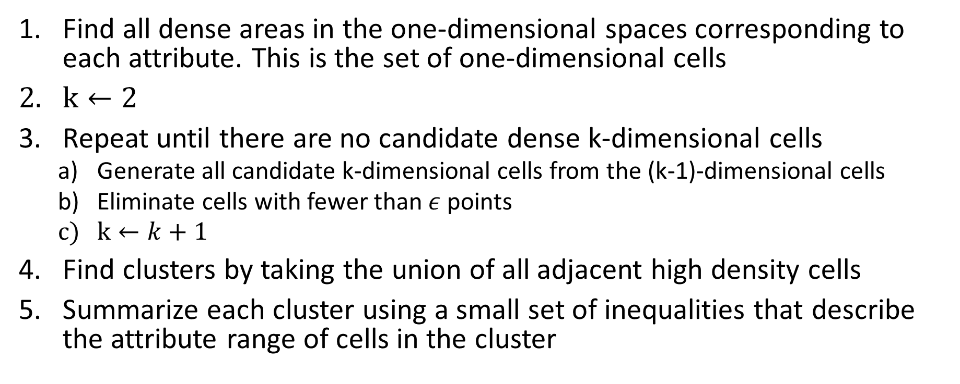
Algorithm CLIQUE
Find all dense areas in the one-dimensional spaces corresponding to each attribute. This is the set of one-dimensional cells
$k←2$
Repeat until there are no candidate dense k-dimensional cells
Generate all candidate k-dimensional cells from the (k-1)-dimensional cells
Eliminate cells with fewer than $ε$ points
$k←k+1$
Find clusters by taking the union of all adjacent high density cells
Summarize each cluster using a small set of inequalities that describe the attribute range of cells in the cluster

Slide 78
Advantages
Insensitive to the order of input of the objects
Good scalability as number of dimensions increase
Flaws
Need proper tuning of grid size
Difficult to find clusters of different densities with different dimensional spaces

Slide 79
K-Means
X | Y | Distance from C1 | Distance from C2 | Cluster
8 | 7
3 | 7
4 | 9
9 | 6
8 | 5
5 | 8
7 | 3
8 | 4
7 | 5
4 | 5

Slide 80
K-Means
X | Y | Distance from C1 | Distance from C2 | Cluster
8 | 7
3 | 7
4 | 9
9 | 6
8 | 5
5 | 8
7 | 3
8 | 4
7 | 5
4 | 5

Slide 81
K-Medoid
X | Y | Distance from C1 | Distance from C2 | Cluster
8 | 7
3 | 7
4 | 9
9 | 6
8 | 5
5 | 8
7 | 3
8 | 4
7 | 5
4 | 5

Slide 82
K-Medoid
X | Y | Distance from C1 | Distance from C2 | Cluster
8 | 7
3 | 7
4 | 9
9 | 6
8 | 5
5 | 8
7 | 3
8 | 4
7 | 5
4 | 5

Slide 83
Probabilistic Model-Based Clustering

Slide 84
Need for flexible clusters
A cluster is a set of objects in which any object is closer to the prototype hat defines the cluster than to the prototype of any other cluster

Slide 85
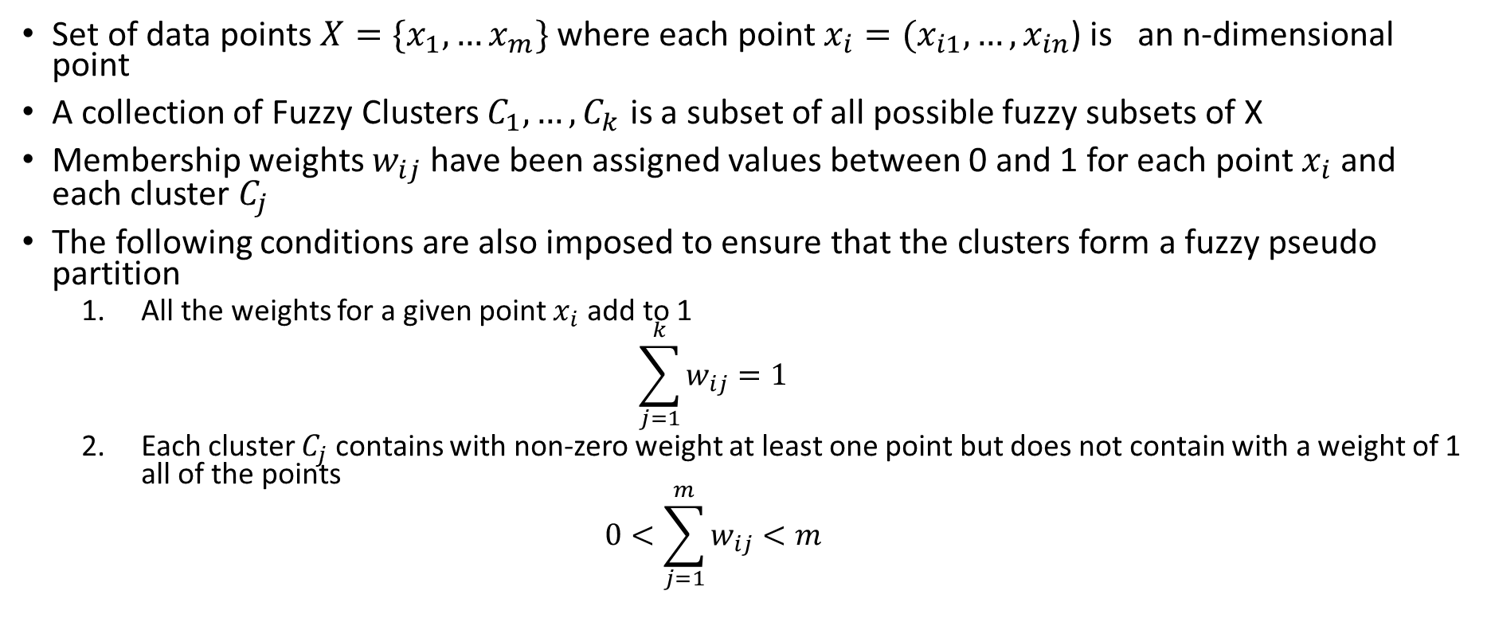
Fuzzy Clusters
Set of data points $X=\{x_{1},…x_{m}\}$ where each point $x_{i}=(x_{i1},…{,x}_{in}$) is an n-dimensional point
A collection of Fuzzy Clusters $C_{1},…{,C}_{k}$ is a subset of all possible fuzzy subsets of X
Membership weights $w_{ij}$ have been assigned values between 0 and 1 for each point $x_{i}$ and each cluster $C_{j}$
The following conditions are also imposed to ensure that the clusters form a fuzzy pseudo partition
All the weights for a given point $x_{i}$ add to 1
$$\sum_{j=1}^{k}{w_{ij}=1}$$
Each cluster $C_{j}$ contains with non-zero weight at least one point but does not contain with a weight of 1 all of the points
$$0<\sum_{j=1}^{m}{w_{ij}}<m$$

Slide 86

Basic Fuzzy C-Means Algorithm
Select an initial fuzzy pseudo partition i.e. assign values to all the $w_{ij}$
Repeat until the centroids do not change
Compute the centroid of each cluster
Recompute the fuzzy pseudo partition i.e. $w_{ij}$

Slide 87
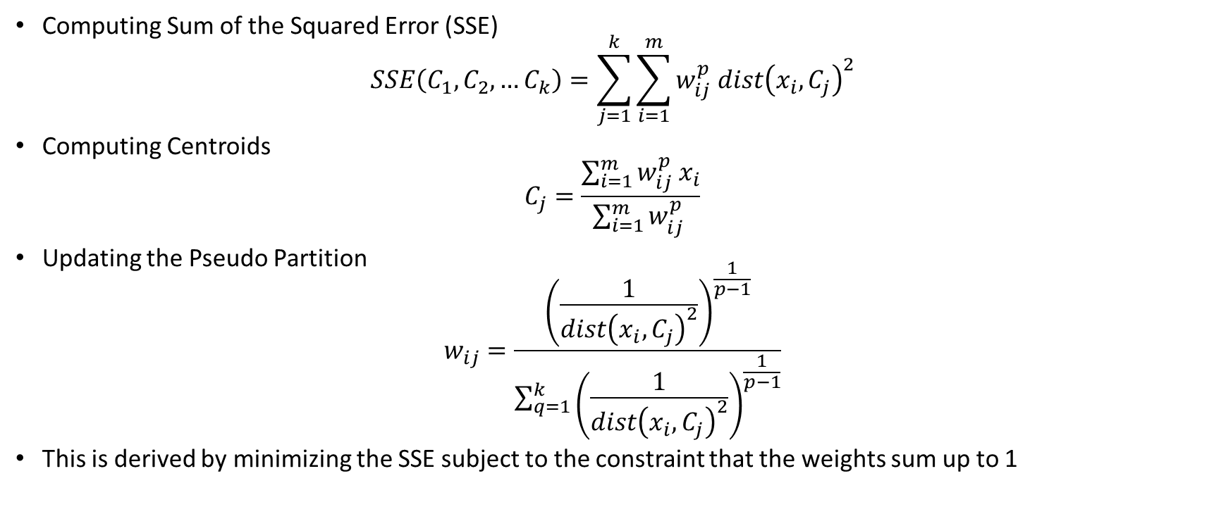
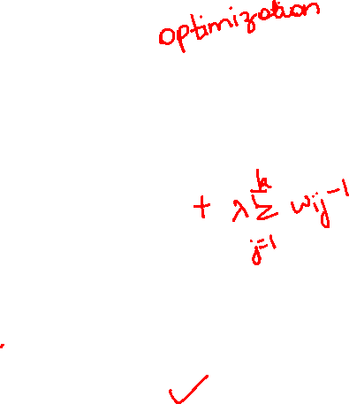
Computing Sum of the Squared Error (SSE)
$$SSE\left(C_{1},C_{2},…C_{k}\right)=\sum_{j=1}^{k}{\sum_{i=1}^{m}{w_{ij}^{p} dist{\left(x_{i}, C_{j}\right)}^{2}}}$$
Computing Centroids
$$C_{j}=\frac{\sum_{i=1}^{m}{w_{ij}^{p} x_{i}}}{\sum_{i=1}^{m}{w_{ij}^{p} }}$$
Updating the Pseudo Partition
$$w_{ij}=\frac{{\left(\frac{1}{dist{\left(x_{i}, C_{j}\right)}^{2}}\right)}^{\frac{1}{p−1}}}{\sum_{q=1}^{k}{{\left(\frac{1}{dist{\left(x_{i}, C_{j}\right)}^{2}}\right)}^{\frac{1}{p−1}}}}$$
This is derived by minimizing the SSE subject to the constraint that the weights sum up to 1

Slide 88
Expectation Maximization Algorithm
Maximum Likelihood Estimation: Used for estimating parameters for simple statistical models
Expectation Maximization Algorithm: Makes an initial guess for the parameters and then iteratively improves these estimates

Slide 89
EM Algorithm
Select an initial set of model parameters
Repeat until the parameters do not change
Expectation Step: For each object, calculate the probability that each object belongs to each distribution
Maximization Step: Given the probabilities from the expectation step, find the new estimates of the parameters that maximize the expected likelihood

